Slide 1
Data Structures and Algorithms
Lecture 3: Stacks
Department of Computer Science & Technology
United International College

Slide 2
Outline
Stack ADT
Basic operations of stack
  Pushing, popping etc.
Applications of stacks
Implementations of stacks using
  array
  linked list

Slide 3
Stack ADT
Stack is a special list where insertion and deletion take place at the same end
  This end is called top
  The other end is called bottom
Everything happens at the top
Nothing happens at the bottom
6
8
4
3
top
bottom

Slide 4
Stack Animation
http://liveexample.pearsoncmg.com/liang/animation/animation.html
Stacks are known as LIFO (Last In, First Out) lists.

Slide 5
Push and Pop
Primary operations: Push and Pop
Push
  Add an element to the top of the stack
Pop
  Remove the element at the top of the stack
Top
  Return, without removing, the element at the top
empty stack
push A
push B
pop
top
B
top
top
top
A
A
A

Slide 6
Stack Applications
Expression evaluation
Backtracking
Memory Management

Slide 7
Implementation of Stacks
Recall the reason why we usually don't implement the list using array?
Topic |  | Array | Linked List
Efficiency | push
 | pop
 | Top
space
Notes:
Why? Insert Operation is low-efficient in array.
Both constant time for all, but array is a little faster, don’t operate pointers and allocate space.
Space: max_N, 2N

Slide 8
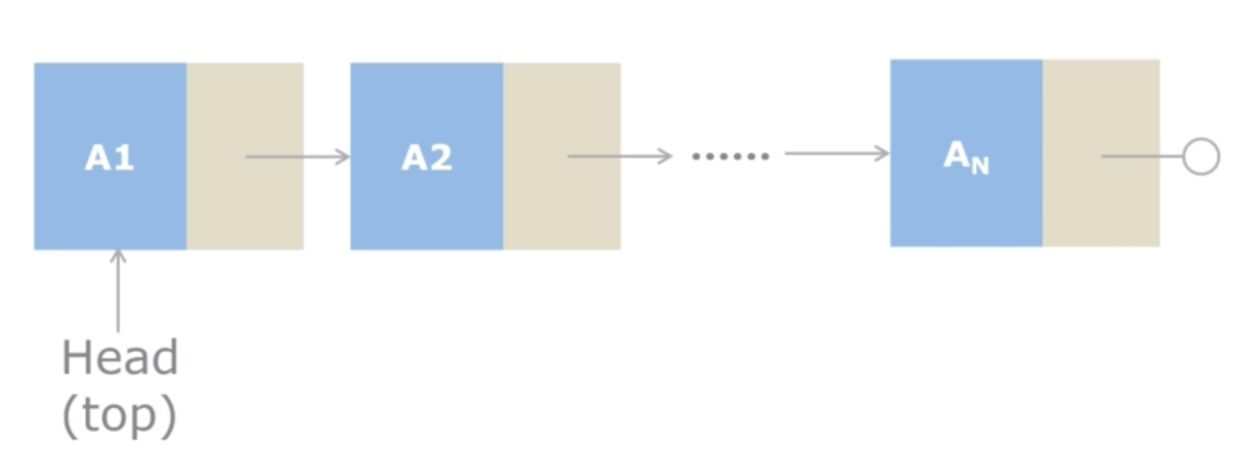
Linked List Implementation

Slide 9
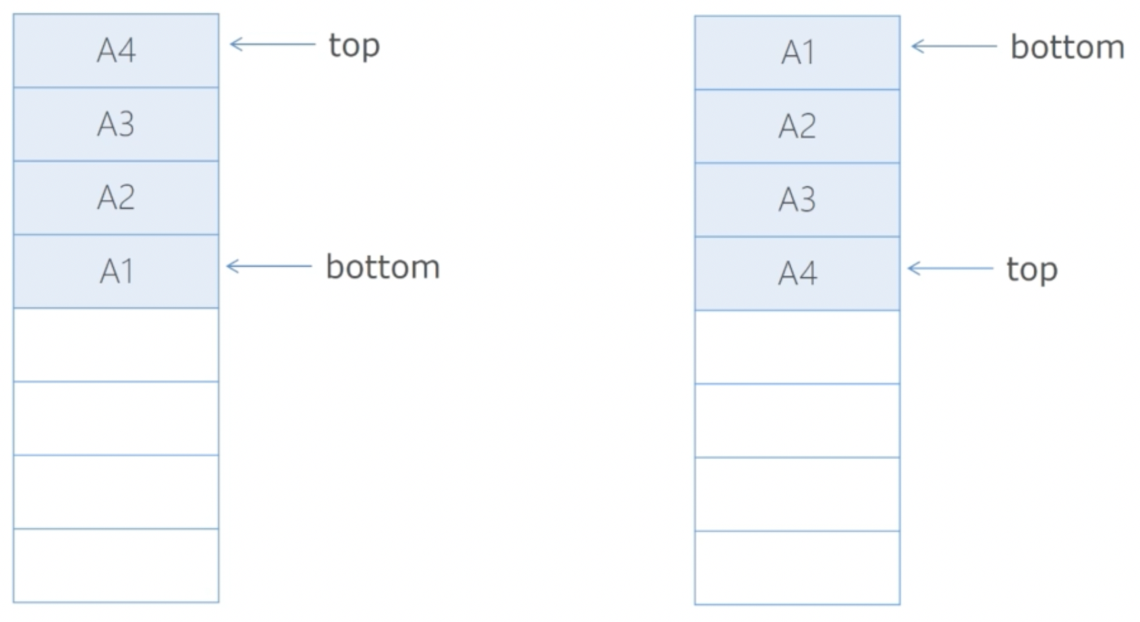
Array Implementation: Which is Better?

Slide 10
Stack Implementation
Data are stored in an array
  values: an array which stores elements of stack
    values can be of any data type but we use Double for demonstration
  top: the index of the top element of stack

Slide 11
Stack Implementation
Class: Stack
Stack
values: Double[] top: int
+ Stack(int size) + isEmpty(): boolean + isFull(): boolean + top(): Double + push(double x): Double + pop(): Double + displayStack():void
Setters and getters are not listed.

Slide 12
Methods
public Stack(int size)
  Creates an empty stack whose capacity is size
public boolean isEmpty()
  Returns true if the stack is empty and false otherwise
public boolean isFull()
  Returns true if the stack is full and false otherwise
public Double top()
  Returns the top element
  Returns null if the stack is empty

Slide 13

Methods
public Double push(double x)
  Adds a new element with value x to the top of the stack
  Returns the new element if the operation is successful and null otherwise
public Double pop()
  Removes and returns the top element of the stack
  Returns null if the operation fails
public void displayStack()

Slide 14
The Constructor
public Stack(int size) {
values = new Double[size];
top = -1;
}
Why?

Slide 15
Push
public Double push(double x) {
if(isFull())
return null;
values[++top] = Double.valueOf(x);
return top();
}
This explains.

Slide 16
displayStack
public void displayStack() {
System.out.print("top -->");
for(int i =top; i >= 0; i --)
System.out.println("\t|\t " +
String.format("%, .4f",values[i].doubleValue()) +
"\t|");
System.out.println("\t+-----------------------+");
}
Check it online!

Slide 17
Using Stack
public static void main(String[] args) {
Stack myStack = new Stack(4);
System.out.println(myStack.isEmpty());
myStack.push(-3);
myStack.push(5);
System.out.println("The stack has 2 items:");
myStack.displayStack();
myStack.push(1);
myStack.push(2);
myStack.push(-1);
System.out.println("The stack has 4 items:");
myStack.displayStack();
System.out.println("The top is: " + myStack.top());
System.out.println(myStack.isFull());
myStack.pop();
myStack.pop();
myStack.pop();
myStack.pop();
System.out.println("The stack is empty:");
myStack.displayStack();
}

Slide 18
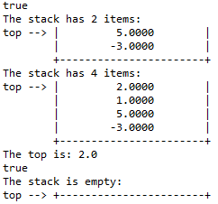
Using Stack
public static void main(String[] args) {
Stack myStack = new Stack(4);
System.out.println(myStack.isEmpty());
myStack.push(-3);
myStack.push(5);
System.out.println("The stack has 2 items:");
myStack.displayStack();
myStack.push(1);
myStack.push(2);
myStack.push(-1);
System.out.println("The stack has 4 items:");
myStack.displayStack();
System.out.println("The top is: " + myStack.top());
System.out.println(myStack.isFull());
myStack.pop();
myStack.pop();
myStack.pop();
myStack.pop();
System.out.println("The stack is empty:");
myStack.displayStack();
}

Slide 19
Task
Complete Stack.java which implements the stack class
  The class is defined on slide 9.
  A main function has been given for the class which tests 6 functions: push, pop, top, isEmpty, isFull, displayStack
Submit stack.java to iSpace.

